Slide 1
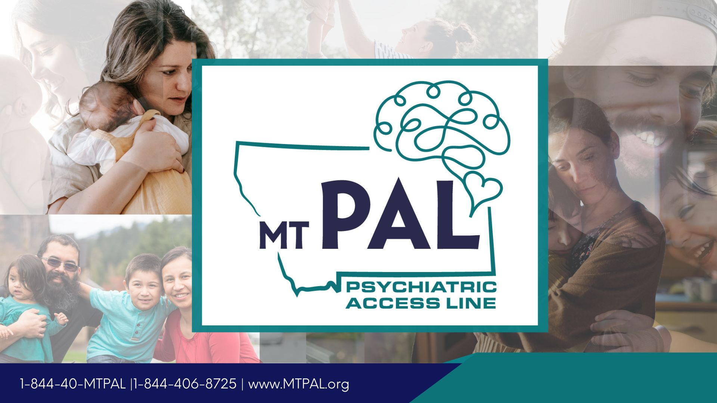

Slide 2

Acknowledgement of Federal Funding
MTPAL for Children dba MAPP-Net program is supported by the Health Resources and Services Administration (HRSA) of the U.S. Department of Health and Human Services (HHS) as part of an award totaling $877,033.00 with 20% financed with non-governmental sources. The contents are those of the author(s) and do not necessarily represent the official views of, nor an endorsement, by HRSA, HHS, or the U.S. Government. For more information, please visit HRSA.gov.

Slide 3

Trauma-Informed Care
Supporting Children with ACEs & PTSD by Dr. Eric Arzubi

Slide 4

The long-term mental health impact of childhood trauma
63.9% of U.S. adults report at least one ACE; 17.3% report four or more
The most common ACEs are emotional abuse (34%), parental separation (28%), and household substance abuse (27%)
Children from marginalized communities face disproportionate risk: American Indian/Alaska Native children have 32.4% prevalence of 4+ ACEs

Slide 5
COVID-19 Impact
More than 140,000 children lost a caregiver during the pandemic
Emergency department visits for mental health increased 31% for adolescents in 2020
Teen girls' suspected suicide attempts increased 51% in early 2021

Slide 6
How childhood trauma affects brain development
Neurobiological Changes:
Hippocampus: Reduced volume affects memory and learning—children with trauma show measurable decreases in the brain region critical for forming new memories
Prefrontal cortex: Decreased gray matter volume impairs executive function, decision-making, and impulse control—essentially, the brain's "CEO" is compromised
Amygdala: Increased volume and hyperactivity creates a hair-trigger stress response—these children are literally wired for survival mode
HPA axis: Chronic cortisol elevation during development creates "toxic stress," permanently altering stress response systems
Epigenetic Impact: Recent 2024 research shows trauma causes hypermethylation of the glucocorticoid receptor gene (NR3C1), creating biological changes that can be passed to the next generation. This means childhood trauma literally changes how genes are expressed.

Slide 7
Mental health outcomes and longitudinal data
Immediate Impact in Children:
Children with ACEs have 2-fold higher odds of depression and 1.94-fold higher odds of anxiety disorders
For children with 4+ ACEs: 25 times higher rate of suicide attempts during the pandemic compared to those with no ACEs
Long-term Adult Outcomes:
Dose-response relationship: Each additional ACE increases mental disorder risk
  0 ACEs: baseline
  1 ACE: 1.5x increased risk
  2-3 ACEs: 2-3x increased risk
  4+ ACEs: 3.11x increased odds for mental disorders, 12x higher odds for suicide attempts

Slide 8
Economic Impact:
ACEs cost $748 billion annually in North America alone.
Early intervention could prevent 21 million cases of depression and 89% of suicide attempts among high school students.

Slide 9
Implementing trauma-informed care in pediatric practice
Evidence-based frameworks
The 4 R's Framework (SAMHSA's foundation for all TIC):
1. Realize the widespread impact—remember, 2/3 of your pediatric patients have experienced trauma
2. Recognize signs in patients AND families—behavioral problems, somatic complaints, developmental regression
3. Respond by integrating knowledge into all interactions—from check-in to examination
4. Resist re-traumatization—offer choices, explain procedures, respect boundaries

Slide 10
AAP's 5-Strategy Implementation (2021 Clinical Report):
1. Awareness of trauma prevalence
2. Readiness assessment of your practice
3. Detection through validated screening
4. Management with evidence-based approaches
5. Integration across all practice workflows

Slide 11
Top Validated Screening Tools:
PEARLS (Pediatric ACEs and Related Life Events Screener):
Validated for ages 0-21, takes 5-10 minutes
17 items covering ACEs plus additional stressors
Successfully implemented in California with nearly 1 million children screened since 2020
$29 Medi-Cal reimbursement per screening
CATS (Child and Adolescent Trauma Screen):
Based on DSM-5 criteria, 15-minute administration
Available in 7 languages including Spanish and Arabic
Screens for trauma exposure, symptoms, functional impact, and suicidality

Slide 12
Implementation Success Factors:
Electronic health record integration is crucial—automate scoring and clinical decision support
Brief training works: 6-hour CME courses show significant improvements in provider knowledge and confidence
Universal screening in behavioral health identifies trauma in >50% of patients
Workflow tip: Administer during waiting time like developmental screens

Slide 13
Effectiveness data
Provider Impact:
After trauma-informed training: Significant improvements in provider knowledge (p < 0.001) and comfort with trauma-exposed patients
Train-the-trainer models are most cost-effective and generate sustainable change
Patient Outcomes:
Reduced hospitalization length of stay
Decreased emergency department utilization
Improved family engagement and treatment adherence
Earlier identification leads to better long-term outcomes

Slide 14
Return on Investment:
Potential to save $1.4 billion over a decade when implemented in social services and schools
Screening cost of $74 per child (including follow-up) yields substantial long-term healthcare savings

Slide 15
Supporting children exposed to abuse, neglect, and violence
Evidence-based therapeutic approaches
Trauma-Focused Cognitive Behavioral Therapy (TF-CBT)—The Gold Standard:
Effect sizes: Cohen's d = 0.96 for PTSD symptoms, 1.15 for depression
12-16 weekly sessions following the "PRACTICE" model
Superior to treatment-as-usual with benefits sustained at 12-month follow-up
Lower dropout rates than other trauma treatments
Available via telehealth with comparable outcomes

Slide 16
Evidence-based therapeutic approaches
EMDR for Children:
Meta-analysis shows medium effect size (d = 0.56) for PTSD symptoms
95.5% completion rate vs 41% dropout in other therapies
Doesn't require detailed verbal recounting—ideal for younger children
2-12 sessions based on complexity
Parent-Child Interaction Therapy (PCIT):
Large effect sizes (d = 1.65) for behavioral problems
Live coaching model helps parents in real-time
Reduces risk of re-abuse
Particularly effective for physical abuse histories

Slide 17
Family involvement strategies
Key Evidence-Based Approaches:
Child-Parent Psychotherapy (CPP): Gold standard for ages 0-6, addresses intergenerational trauma
Caregiver participation in TF-CBT significantly improves outcomes
Non-offending caregiver support is essential—they need trauma treatment too
Practical Strategies:
Include caregivers in safety planning
Provide psychoeducation about trauma's impact on behavior
Connect families to parent support groups
Address caregiver's own trauma history—epigenetic transmission means parent trauma affects children biologically

Slide 18
Community coordination
Multi-Disciplinary Team Approaches:
Children's Advocacy Centers reduce re-traumatization through coordinated response
Integration with schools, child protective services, and legal systems improves outcomes
Wraparound services address family's multiple needs simultaneously

Slide 19
School-Based Interventions:
CBITS (Cognitive Behavioral Intervention for Trauma in Schools): Group intervention showing significant symptom reduction
Bounce Back for elementary ages: Integrates with school day
School staff training creates trauma-sensitive environments
Technology Solutions:
Telehealth delivery shows equivalent outcomes with increased access
Particularly valuable for rural populations
High caregiver satisfaction rates
Reduces transportation barriers

Slide 20
Your role in breaking the cycle
Key takeaways for immediate action
1. Screen universally: Use PEARLS or CATS at well-child visits—it takes just 5-10 minutes and may be reimbursable
2. Respond with the 4 R's: Realize, Recognize, Respond, Resist re-traumatization in every interaction
3. Know your referral network: Identify TF-CBT and PCIT providers in your community
4. Brief training makes a difference: Even 6 hours of education significantly improves outcomes
5. Focus on relationships: Safe, stable, nurturing relationships are the foundation of healing

Slide 21
The compelling case for action
Remember these numbers:
75% of your adolescent patients have experienced trauma
4+ ACEs increases suicide risk 25-fold
Early intervention could prevent 89% of teen suicide attempts
Your trauma-informed approach today can break intergenerational cycles of trauma

Slide 22
Resources for immediate next steps
Free training: ACEs Aware (2-hour online CME)
Screening tools: NCTSN.org for free, validated instruments
AAP resources: National Center for Relational Health and Trauma-Informed Care
Provider support: Secondary Trauma Toolkit for self-care strategies

Slide 23
Additional Statistics for Q&A or Extended Discussion
Quick Reference Statistics:
Economic impact: $748 billion annually in North America
Prevalence: 63.9% of adults have 1+ ACE; 17.3% have 4+ ACEs
Brain changes: Reduced hippocampal volume, increased amygdala activity, decreased prefrontal cortex gray matter
Treatment effectiveness: TF-CBT effect size d = 0.96-1.15; PCIT d = 1.65 for behavioral problems
Screening time: 5-10 minutes for PEARLS, 15 minutes for CATS
Training impact: 6-hour training significantly improves provider competence
COVID impact: 51% increase in teen girl suicide attempts, 140,000 children lost caregivers

Slide 24
References
American Academy of Pediatrics. (2021). Trauma-informed care clinical report. Pediatrics, 148(2), e2021052580. https://doi.org/10.1542/peds.2021-052580
American Academy of Pediatrics. (2023). What is trauma-informed care? https://www.aap.org/en/patient-care/national-center-for-relational-health-and-trauma-informed-care/what-is-trauma-informed-care/
American Academy of Pediatrics. (2023). Trauma-informed care resources. https://www.aap.org/en/patient-care/trauma-informed-care/
Centers for Disease Control and Prevention. (2023). Adverse Childhood Experiences (ACEs). https://www.cdc.gov/aces/about/index.html
Centers for Disease Control and Prevention. (2023). Adverse Childhood Experiences data. MMWR. https://www.cdc.gov/mmwr/volumes/73/su/su7304a5.htm
Felitti, V. J., Anda, R. F., Nordenberg, D., Williamson, D. F., Spitz, A. M., Edwards, V., ... & Marks, J. S. (1998). Relationship of childhood abuse and household dysfunction to many of the leading causes of death in adults: The Adverse Childhood Experiences (ACE) Study. American Journal of Preventive Medicine, 14(4), 245–258.
Lancet Public Health. (2017). The public health impact of adverse childhood experiences: Systematic review and meta-analysis. The Lancet Public Health, 2(8), e356–e366. https://doi.org/10.1016/S2468-2667(17)30118-4
National Center for Biotechnology Information. (2014). Trauma-Informed Care in Behavioral Health Services (SAMHSA TIP 57). https://www.ncbi.nlm.nih.gov/books/NBK207192/
Peña, C. J., et al. (2019). Childhood trauma and epigenetic regulation of stress response. Scientific Reports, 9, 19601. https://www.nature.com/articles/s41598-018-36689-2
PubMed Central. (2016). Implementing trauma-informed care: Screening and outcomes in pediatric practice.https://pmc.ncbi.nlm.nih.gov/articles/PMC4939592/
PubMed Central. (2023). Trauma-informed practice and neurobiology. https://pmc.ncbi.nlm.nih.gov/articles/PMC10817356/
PubMed Central. (2024). Epigenetic changes and intergenerational trauma. https://pmc.ncbi.nlm.nih.gov/articles/PMC11083630/
PubMed Central. (2023). Trauma therapy effectiveness. https://pmc.ncbi.nlm.nih.gov/articles/PMC5051697/
PubMed Central. (2023). Trauma-informed pediatric interventions. https://pmc.ncbi.nlm.nih.gov/articles/PMC10240654/
PubMed Central. (2023). School-based trauma programs. https://pmc.ncbi.nlm.nih.gov/articles/PMC9872563

Slide 25
References
ResearchGate. (2023). Prospective longitudinal associations between adverse childhood experiences and adult mental health outcomes: A protocol for a systematic review and meta-analysis. https://www.researchgate.net/publication/374333675
ScienceDirect. (2022). ACEs and adult mental health. Journal of Psychiatric Research, 151, 456–465. https://www.sciencedirect.com/science/article/abs/pii/S0022395622005623
ScienceDirect. (2019). Trauma-focused CBT effectiveness in children. Child Abuse & Neglect, 96, 104089. https://www.sciencedirect.com/science/article/abs/pii/S0190740919315142
ScienceDirect. (2022). EMDR treatment outcomes for children. Journal of Anxiety Disorders, 92, 102626. https://www.sciencedirect.com/science/article/abs/pii/S0145213422004331
ScienceDirect. (2009). Parent-Child Interaction Therapy outcomes. Clinical Psychology Review, 29(7), 593–602. https://www.sciencedirect.com/science/article/abs/pii/S0272735809000890
Sage Journals. (2023). Parent-Child Interaction Therapy (PCIT) outcomes. Journal of Child and Family Studies, 32(4), 1125–1138. https://journals.sagepub.com/doi/10.1177/10775595231167383
Taylor, L. K., et al. (2020). Eye movement desensitization and reprocessing in children and adolescents: A meta-analysis. European Journal of Psychotraumatology, 11(1), 1767987. https://doi.org/10.1080/20008198.2020.1767987
Taylor & Francis Online. (2025). Trauma-informed school interventions. Scandinavian Journal of Psychology, 66(1), 33–45. https://www.tandfonline.com/doi/full/10.1080/07853890.2025.2536199
Weems, C. F., & Graham, R. A. (2014). Resilience and trajectories of posttraumatic stress among youth exposed to disasters. Current Psychiatry Reports, 16(8), 462. https://doi.org/10.1007/s11920-014-0462-4
Wikipedia. (2024). Eye movement desensitization and reprocessing. https://en.wikipedia.org/wiki/Eye_movement_desensitization_and_reprocessing
PCIT International. (2024). What is Parent-Child Interaction Therapy? https://www.pcit.org/what-is-pcit.html
Frontiers in Psychology. (2023). Trauma-informed practices in schools: A systematic review. https://www.frontiersin.org/journals/psychology/articles/10.3389/fpsyg.2023.1167937/full
PLOS ONE. (2021). Implementation of trauma-informed care practices. PLOS ONE, 16(7), e0252747. https://journals.plos.org/plosone/article?id=10.1371/journal.pone.0252747

